Slide 1
Adapting
Bayesian Filters
For use with
Circular data
Cannon Tuttle, Curtis Evans, Spencer Ashton, Tyler Sanders
BYU ACME Volume 3 - 23 Apr 2024
Notes:
Cannon
Or project is making Kalman-type filters work even when angles wrap around from 360 degrees to 0 degrees.

Slide 2

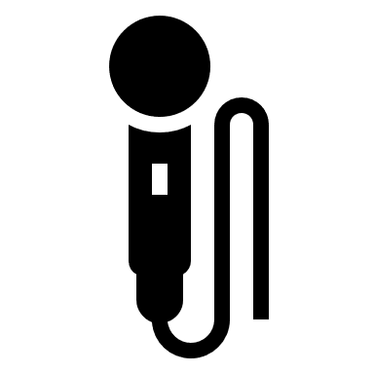
The Problem
Speaker
θ
Microphone Array
Notes:
Tyler
A BYU acoustics project seeks to create an audio system that uses an array of microphones that records the audio of someone speaking in a noisy environment, filters it, and reproduces it through a process that mimics the directionality of the sound. Essentially it should sound to the listener as if there was a speaker at that angle theta in relation to them. In order to reproduce the sound with that sort of directionality, having an accurate estimate for the original angle theta over time is essential. Our part in this project amounted to modifying various Bayesian filters, including the Kalman filter, so that they function properly with the unique properties of circular/angular data.

Slide 3
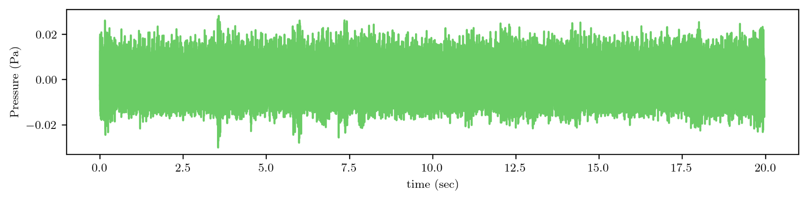
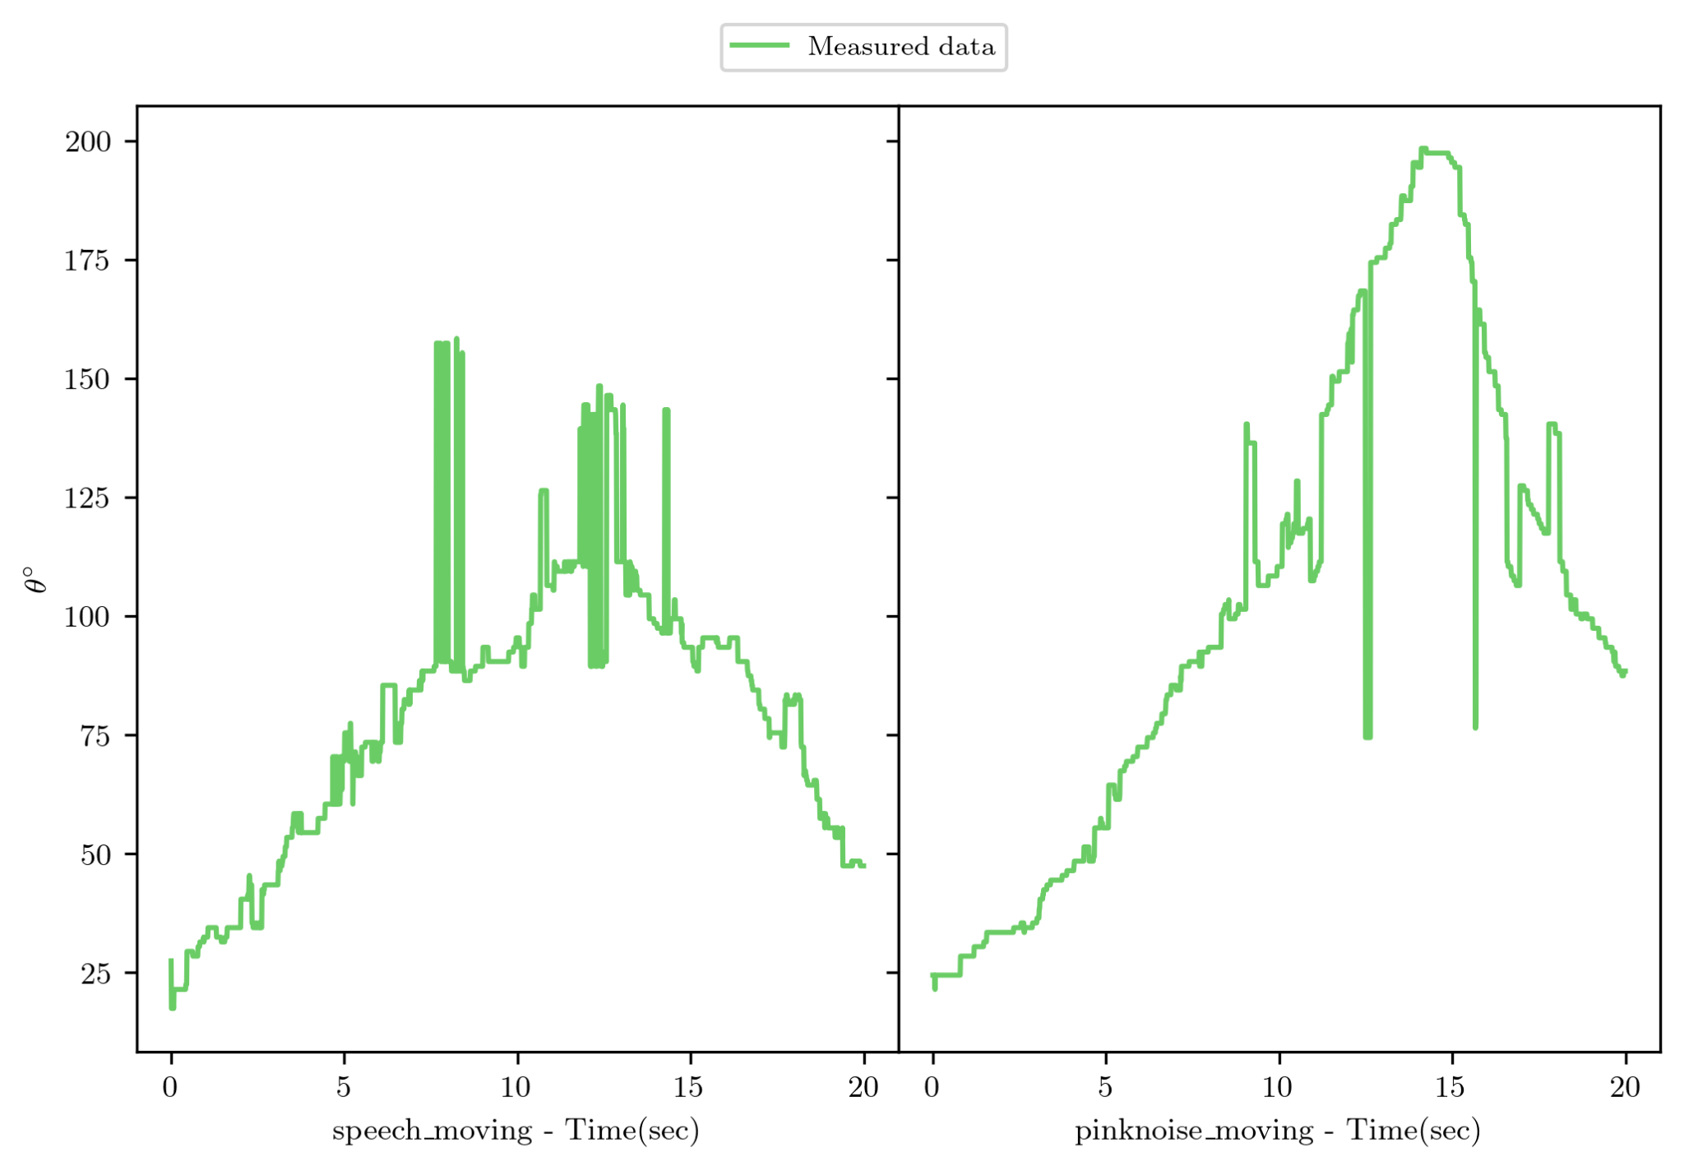
Measured Data
7 Microphone Signal Datasets
Triangulation
Measured Angle Datasets
Notes:
Spencer
Our data for this project was given to us by the research group. The research group used the microphone array to record sounds coming from various angles. The microphones produced pressure measurements, which the research group then converted to angle measurements using triangulation.

Slide 4
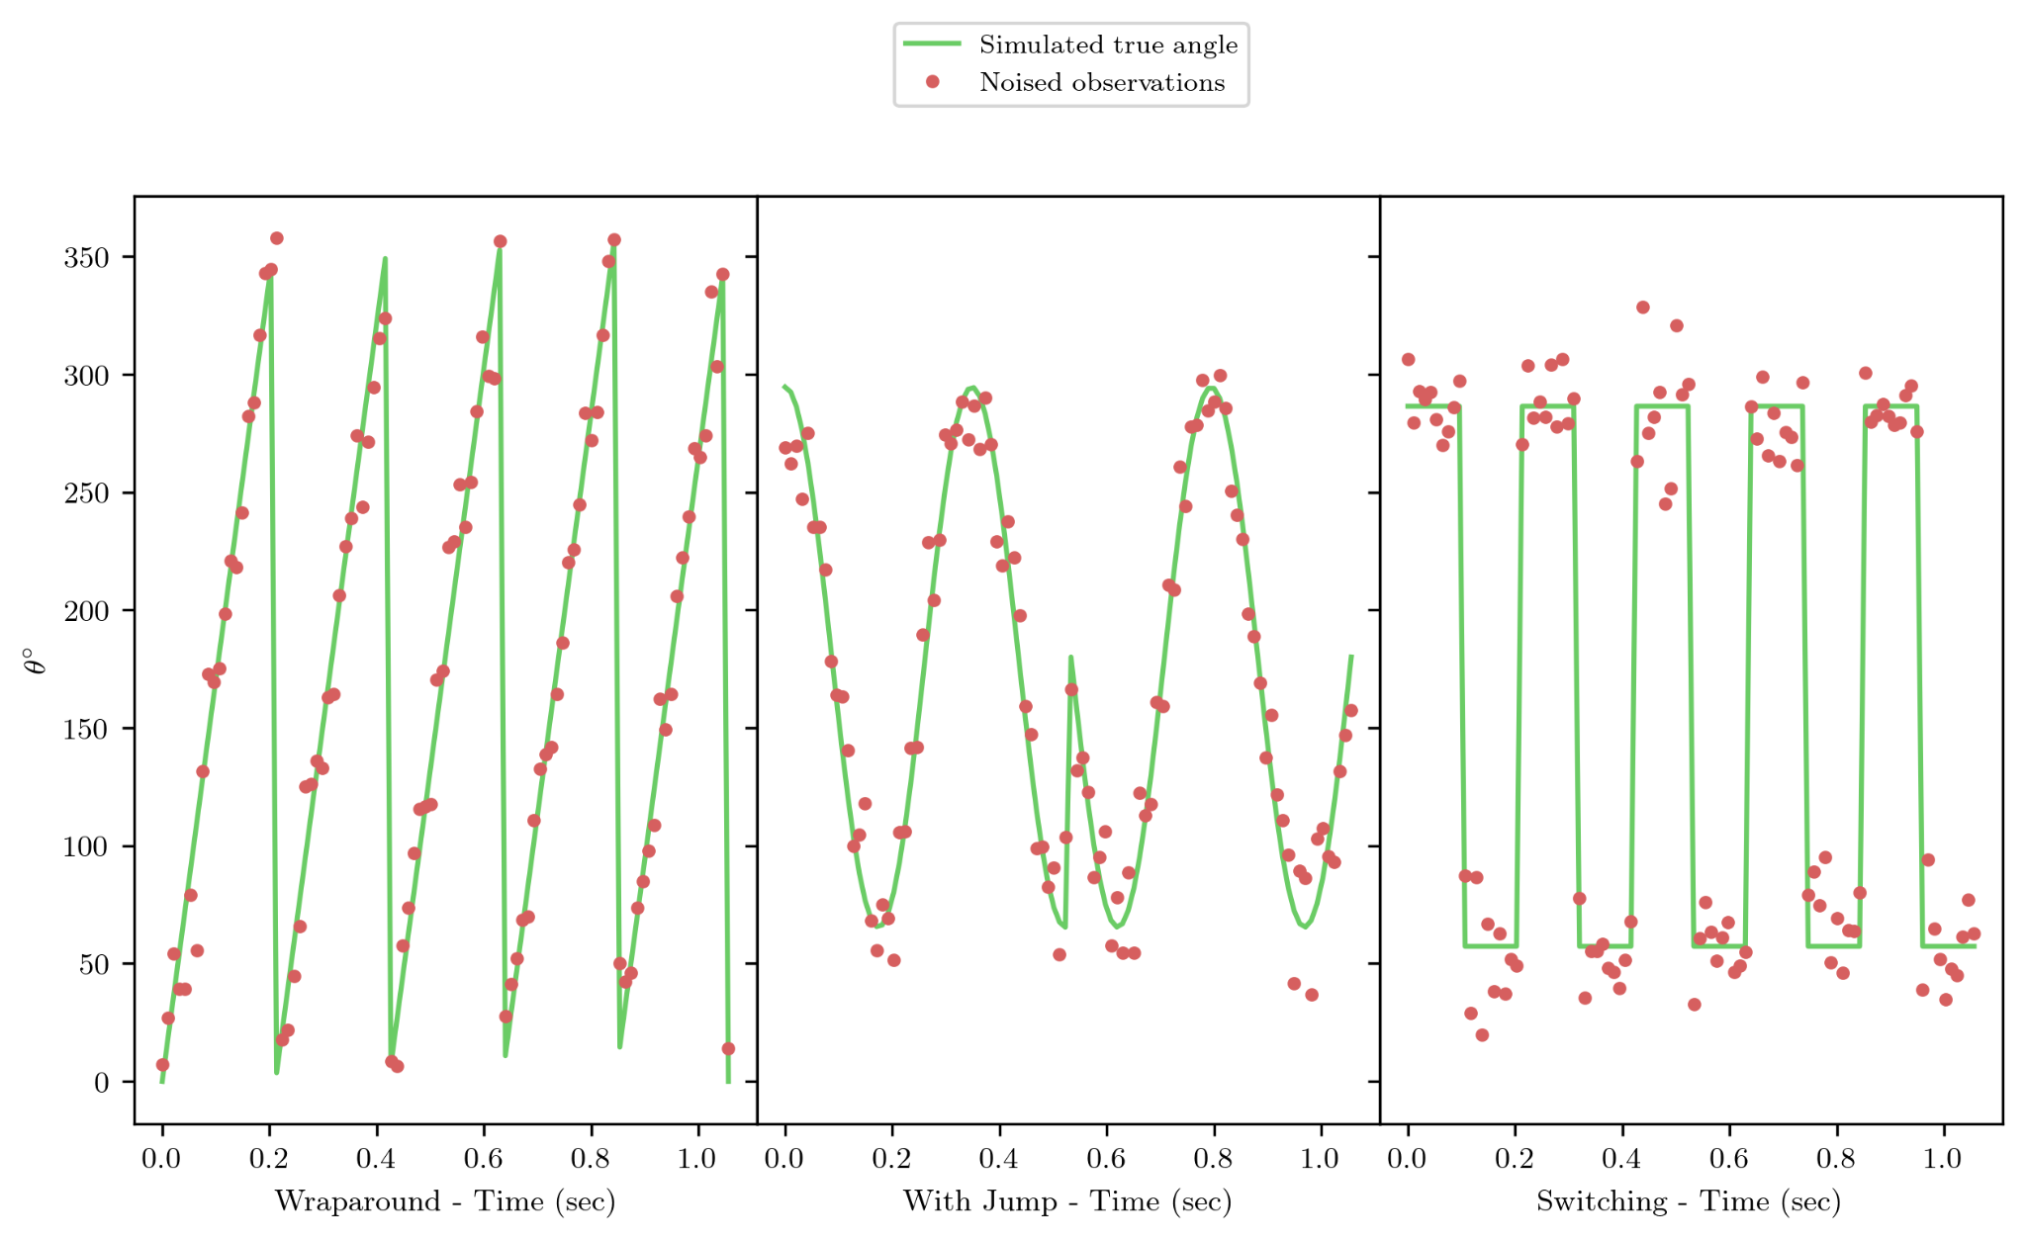
Generated Data
Notes:
Cannon
To guarantee our filters work well with wraparound, we made three different synthetic datasets. The first one is moving around in a circle continuously, the second one is more smooth with one jump in the middle, and the third is constant switching between two angles on either side of 360 degrees.

Slide 5
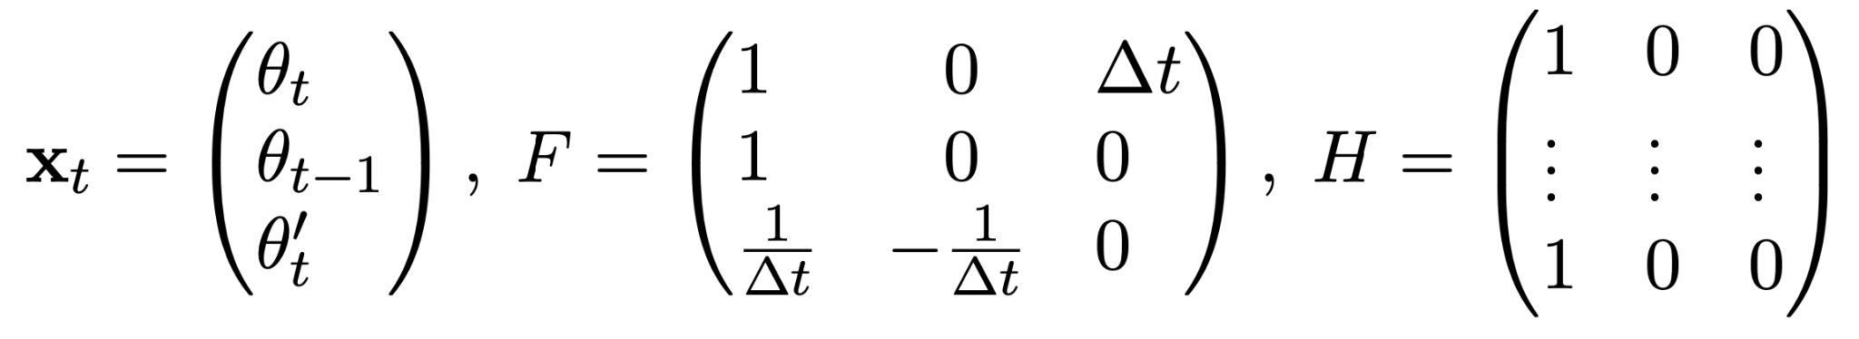
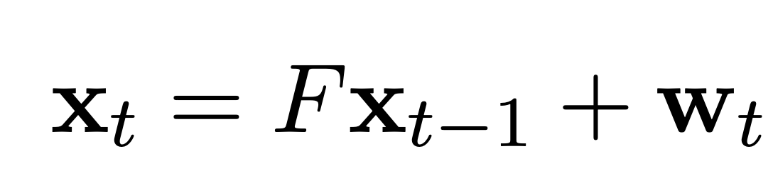
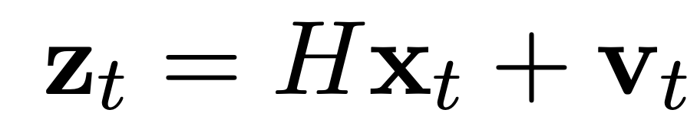
Continuous State Space Model
Notes:
Curtis
We have made this problem a continuous state space model. We have three states in our state space the angle at the time t, angle at time t-1 and angular velocity at time t. We are approximating the angular velocity by doing a finite difference with theta time t and theta time t-1. The observation space is the current angle at time t with however many angle measurements we have. With this continuous state space model set up we could use a standard Kalman Filter and other methods to filter the measured data.

Slide 6
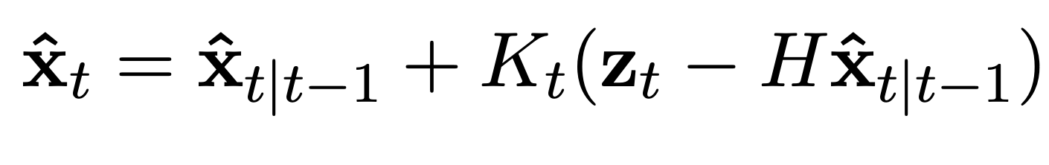
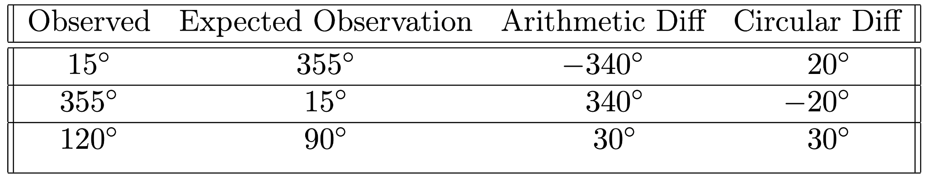
Update Step
Notes:
Spencer
This table shows a problem that can arise when using the Kalman filter on our angle measurements. When calculating the distance between the observed angle measurement and the expected angle measurement, the arithmetic difference is not always accurate. The first line in the table shows that on a circle, the difference between 15 degrees and 355 degrees is 20 degrees. However, the arithmetic difference between 15 and 355 degrees is -340 degrees. The other two lines show similar situations.

Slide 7
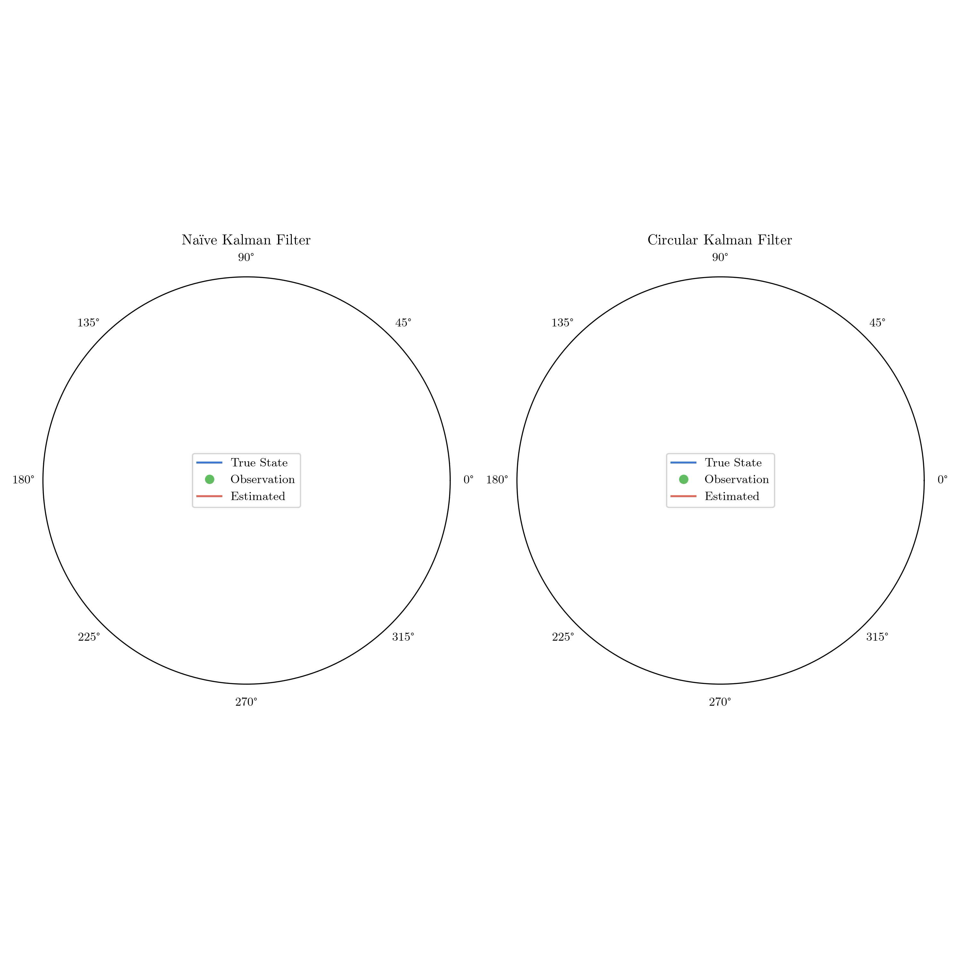
Naïve vs Circular Kalman Filter
Notes:
Curtis
With the new adjustment for circular difference there is a major difference in tracking a moving angle. Here we see a simulated angle that is moving around in a circle and the naive Kalman filter can’t wrap around while the Kalman filter with circular difference is able to completely track the angle around. The naive kalman filter is staying closer to the arithmetic mean of 180 while the circular one completes the circle.

Slide 8
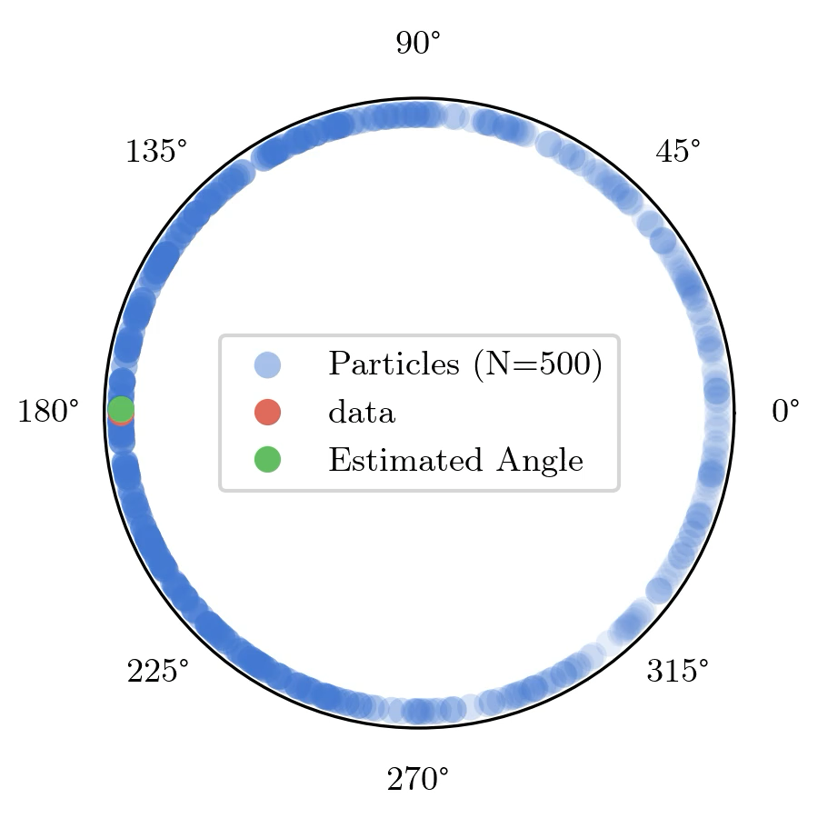
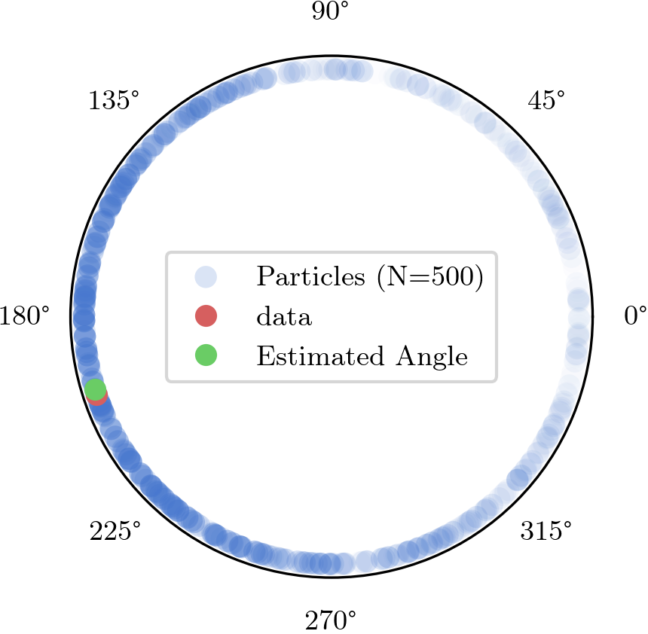
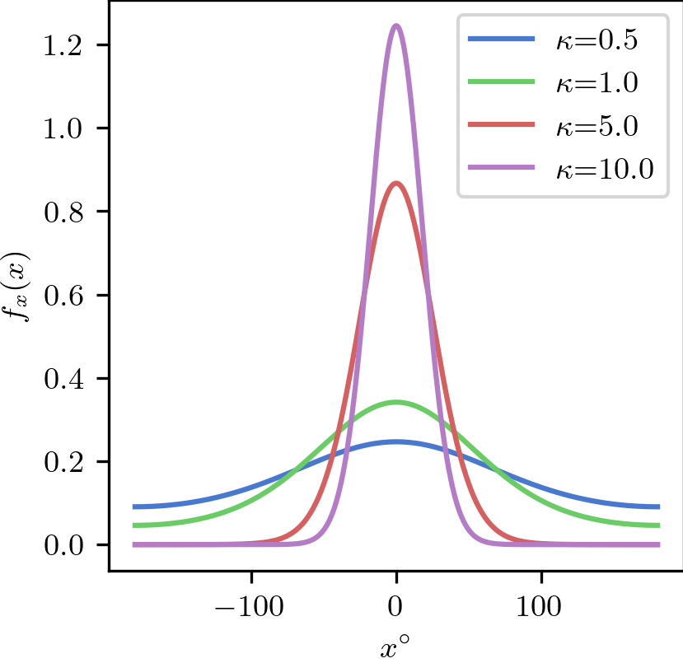
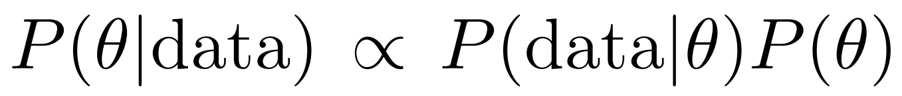
Particle Filter
Notes:
Tyler
The Particle Filter is another variety of Bayesian filter that we implemented. It uses the same state space model as the Kalman filter, but instead keeps track of many potential states at once, with each of these states called a particle. The particles each have a weight, which is thought of as the probability that that particle is the true state, with all weights together summing to 1 to form a probability distribution. The particle filter propagates every these particles forward in time WITH NOISE, then updates the weights/probabilities of the particles using Bayes’ rule. The previous time step’s weight is the prior, P(theta), and the likelihood P(data|theta) is computed according to a predefined distribution. One of the advantages of the particle filter is that the likelihood distribution can be anything. As such, we avoided the pitfalls of the standard Normal distribution by using a circular distribution; in this case we used the Von Mises distribution, a distribution that approximates the standard normal that is wrapped around the circle.
At each time step, the state estimate is found using a weighted circular average of all the particles.

Slide 9
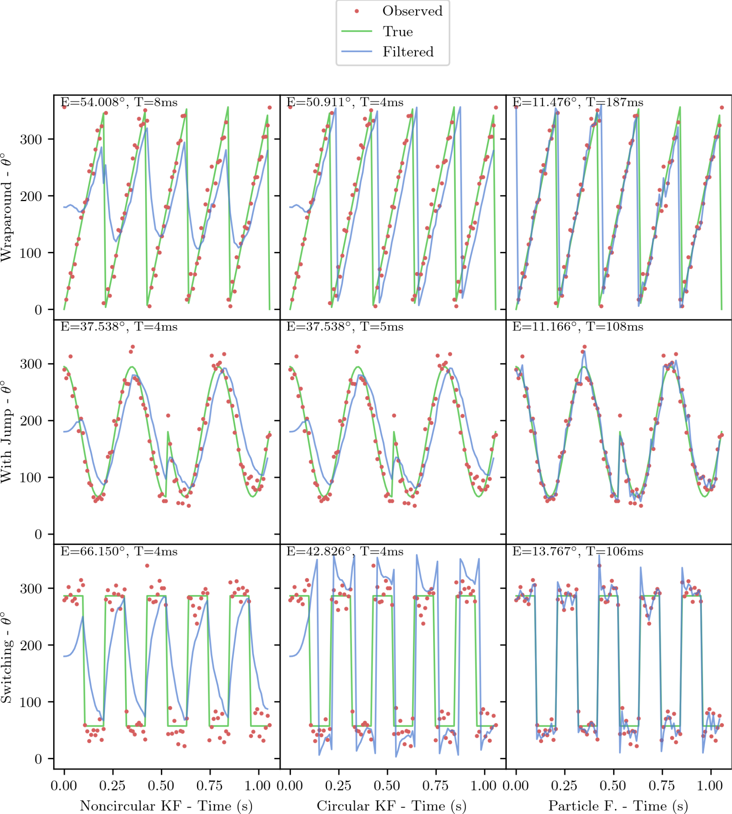
Performance on Simulated Data
Naive KF fails at 0°
Circular KF fixes this
Particle F. more accurate
Notes:
Cannon
On the synthetic dataset, our naive Kalman Filter struggles at the boundary as we’d expect - it takes the long way around the circle here. Both of our adapted filters are able to manage this wraparound. The particle filter ended up having a lower average error, although it takes longer to run.

Slide 10
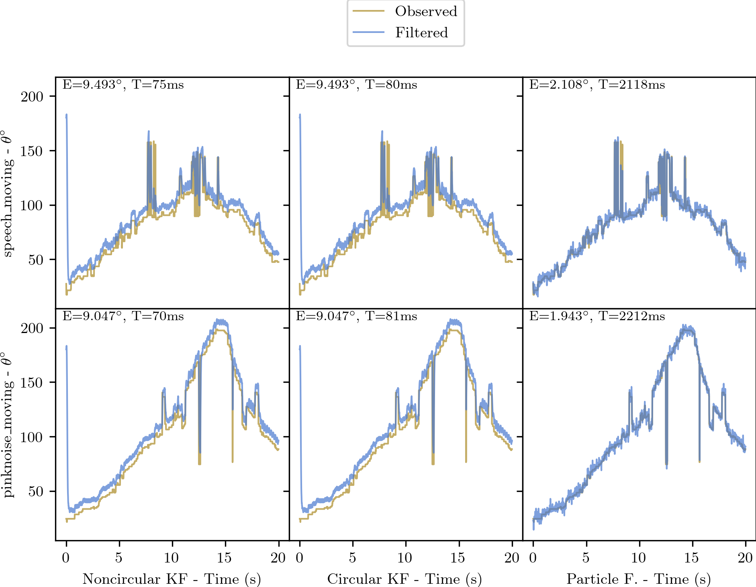
Performance on Actual Data
Both KFs did well
Particle F. more accurate
(E=9° ➡ E=2°)
Notes:
Curtis
We recorded pink noise, another type of gaussian noise, moving from 0 to 180 and then back, so there was no wraparound. The data was then passed through the triangulation algorithm and we ran the filters on the triangulated data. All of the filtered did well on this data, but the particle filter had was 7 degrees more accurate by our error measurement. We would expect the circular kalman filter to outperform the naive filter if there was a wraparound in this data.

Slide 11
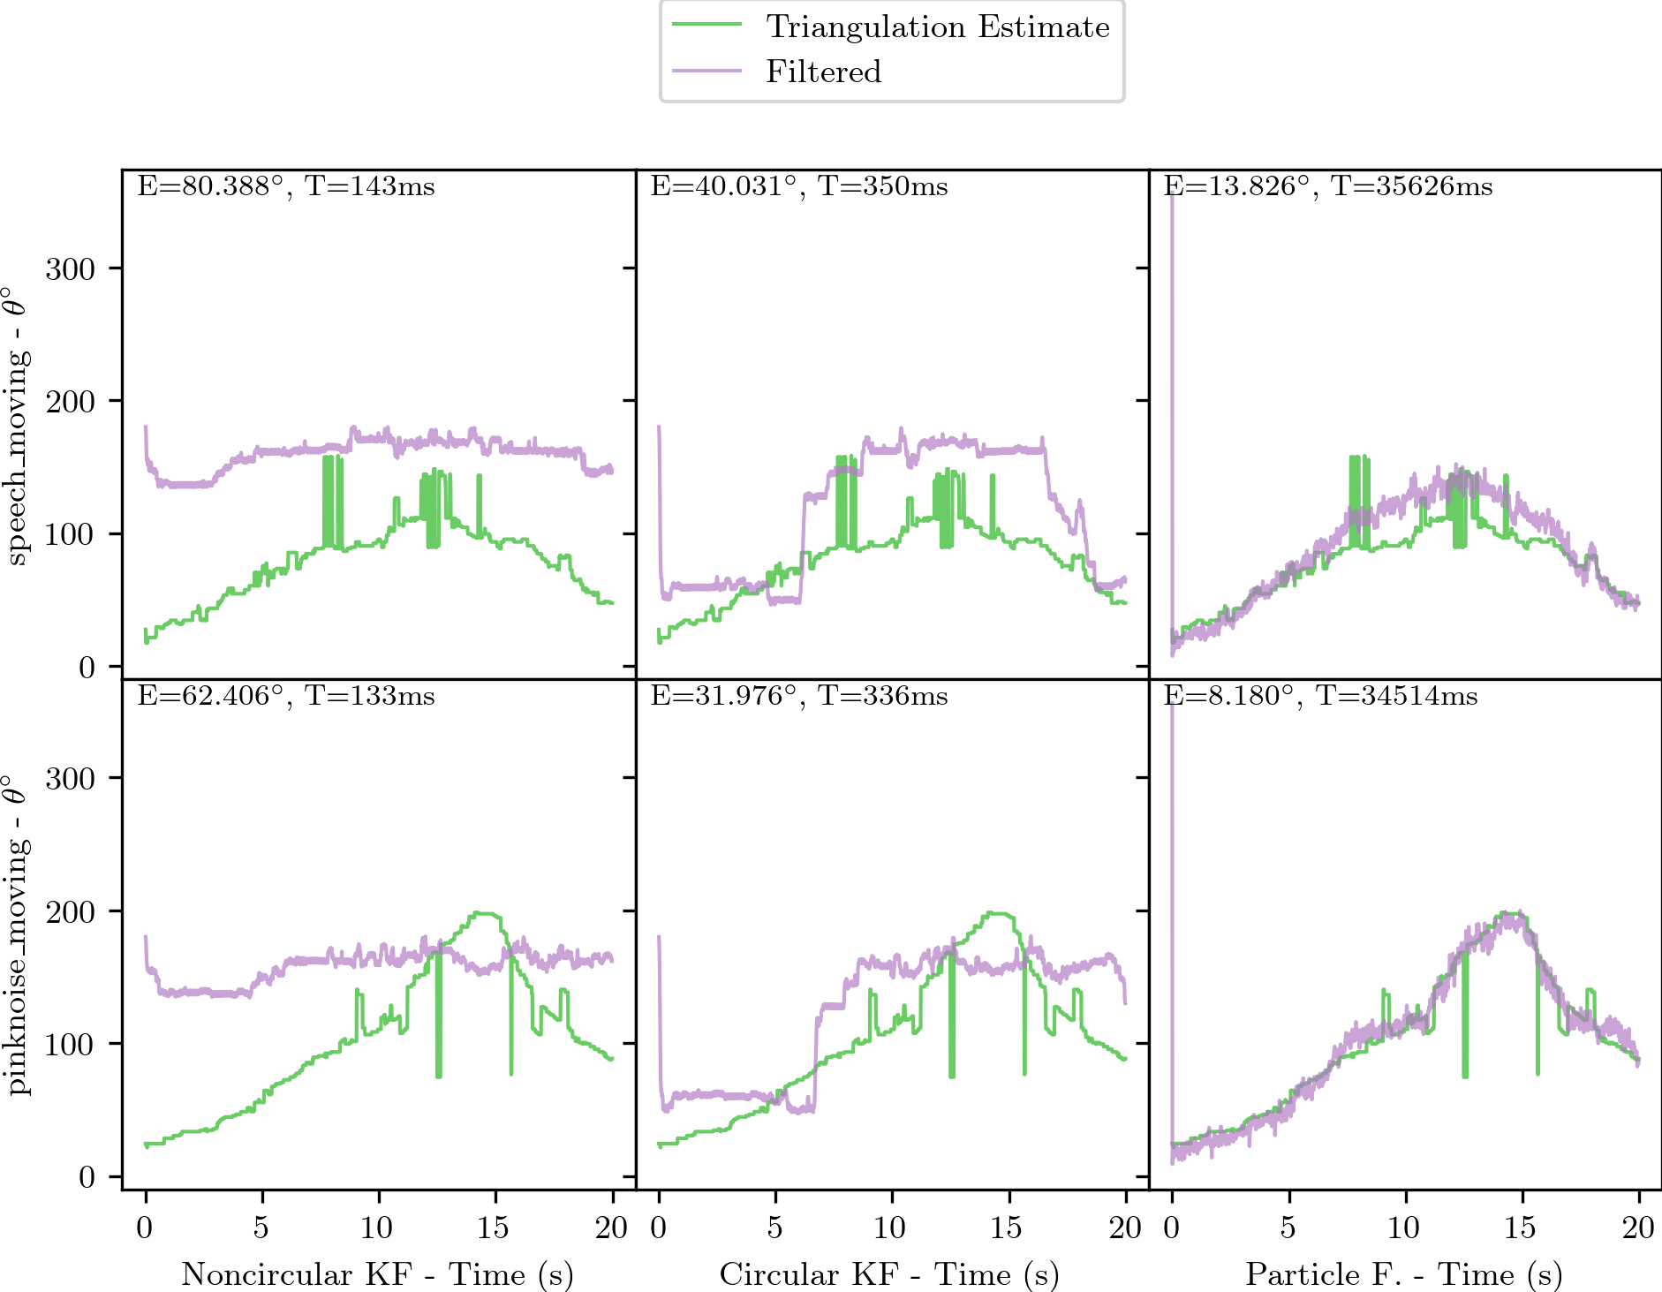
Performance on Actual Data Cont.
Both Kalman Filters fail when incorporating multiple measurements
Particle F. more accurate
Notes:
Tyler
The final case we were able to test goes back to the measurement process. Their algorithm has a way of selecting the most likely angle out of 48 angles, which in most cases we used as our measurement. In this case, we passed all 48 angles directly into the filter to see how they would perform at angle selection. Both Kalman filters do a pretty poor job, with the circular significantly “better”, but still not good. The particle filter on the other hand did a great job at selecting angles, even seeming to smooth out the noise, something very desirable for this use case. We’re not exactly sure why the Kalman filters do so much worse, but we suspect that it could have to do with the fact that the non-symmetric array gave angle measurements that were not normally distributed.
Ultimately, we believe the circular Kalman filter can be suitable for this application, especially if the computational gains are important. If they have the computational headroom, the Particle filter performed remarkably well for the application, and we hope the research group is willing to

Slide 12
Thanks for Listening!

